Slide 1
Industry adoption of Blockchain – Key Use cases — Balaji Viswanathan IBM Software Labs - India

Slide 2

IBM Solutions
Food Trust
TradeLens
World Wire
Digital Identity
Your Solution

Slide 3
IBM Solutions
The aim of this presentation is to provide introductions to IBM blockchain solutions
It is suitable for clients and IBMers wishing to find out more about one or more of these solutions
See also the Client References presentation that gives summary information on many more blockchain projects

Slide 4


Food Trust

Slide 5
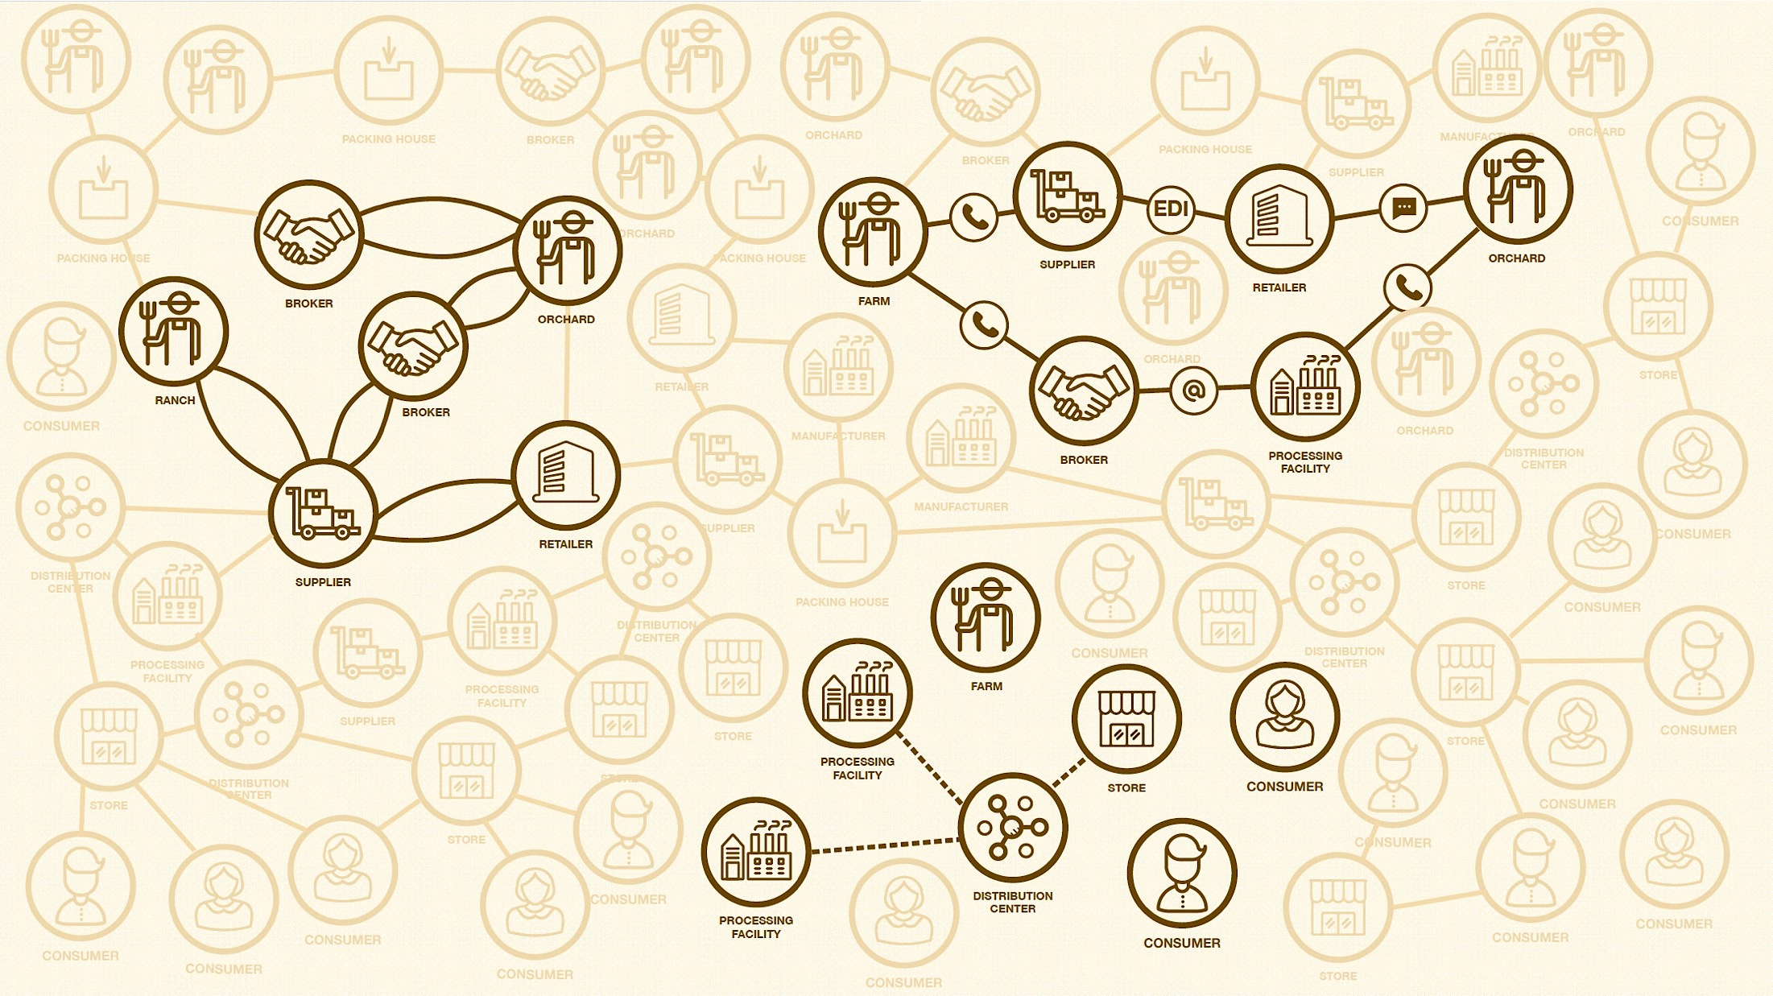

The Food Ecosystem today
Multiple data formats & sources
Lack of trusted, easily auditable records
Data sharing limited to 'one up, one down’ without end-to-end transparency
Incomplete information & inability to effectively communicate with the end consumer
5

Slide 6


Introducing IBM Food TrustTM built on Blockchain technology
The IBM Food Trust solution is a set of modules providing traceability to improve food transparency and efficiency
Blockchain is used to create a trusted connection with shared value for all ecosystem participants, including end consumers
The solution offers connectors for interoperability and leveraging existing standards (e.g., GS1)
Enterprise Ready leveraging the IBM Blockchain Platform to provide enterprise level security and scalability

Slide 7
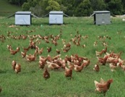
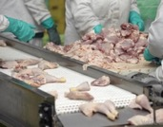
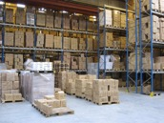
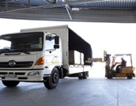
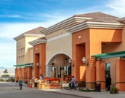
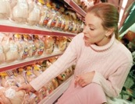

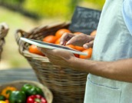
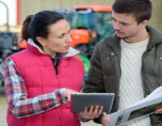
IBM Food Trust provides value to the entire food ecosystem
Prove farm is not a source of outbreak
Ease of connectivity to the supply chain
Instill trust between retails, suppliers & customers
Automate & reduce manual certificate management
Conduct targeted recalls
Enable internal data sharing
Farmers / Producers
Food Manufacturers / CPGs
Wholesalers/ Distributors
Enhance ability to meet compliance standards
Reduce manual processes
Assure customers food supplied is safe
Conduct targeted recalls quickly
Learn about recalls and increased transparency
Reduce risk of being victimized by food fraud
Food Logistics
Food Retailers
Consumers
Reduce fraudulent certificates
Increase renewal speed
Assure customers food supplied Is safe
Reduce wasted food
Identify contamination quickly
Reduce unnecessary testing
Certification Bodies
Food Service
Regulators

Slide 8



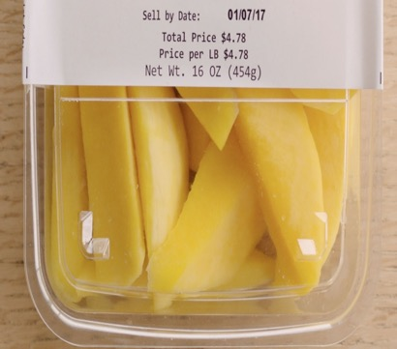


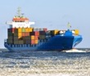
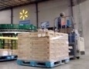
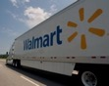
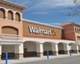

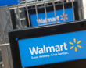
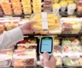
The effectiveness of the IBM Food Trust solution was demonstrated with a Walmart mango pilot
Supply Chain
Pilot Test Case
Results
How long does it take to trace a package of sliced mangoes back to the farm?
Typical manual, mixed digital and paper-based method
6 days
18 hours
26 minutes
IBM Food Trust digital solution
2.2 seconds

Slide 9

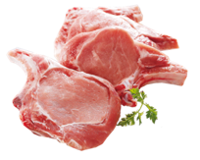
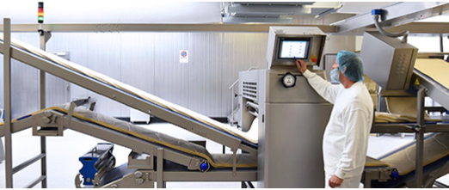



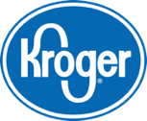
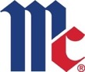
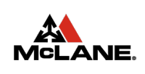
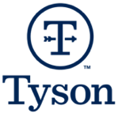
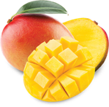
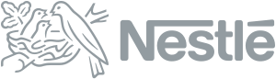

Where are we on our journey?
2016
2017
2018
Additional partners joined the IBM Food Trust™ network, with growing food data transactions
Onboarding agriculture, ingredient suppliers, retailers, CPGs, QSRs and others
conducts traceability pilots
Pork
Traceability / safety
Mango
Traceability / global trade

Slide 10
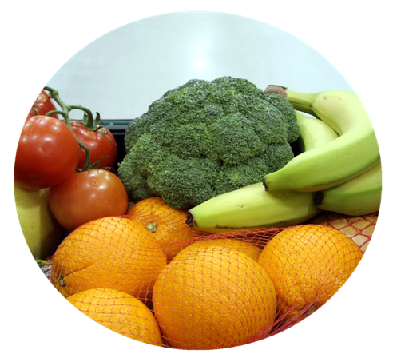
The IBM Food Trust solution is a set of modules built for the industry
Trace & Recall
Data Entry & Access
Certificate Management
Manage Recalls
Recall Post-Analysis
Trace-forward & back
Recall Simulator
IBM Food Trust Solution Core
Version Control
Authenticity
Automated lifecycle management
Real-time Sharing
Permissioned Data Access & Entry
IBM Blockchain Provenance Engine
Secure Document Storage
API Integration
Future 3rd Party Modules / Capabilities
Future IBM Modules
IBM Blockchain Platform
Hyperledger Fabric
Notes:
From the ground up, we built the solution on top of Hyperledger Fabric, which is an open source framework, to support the collaborative development of blockchain-based ledgers. The IBM Blockchain Platform is an enterprise ready blockchain application development solution, from which IBM Food Trust was built.
IBM Food Trust is modular and, in addition to data entry and access, there are two other modules that help to improve food supply chain transparency and efficiency: trace & recall and certificate management. Trace & Recall provides access to end to end food traceability data. Certificate Management gives users the ability to upload, manage, access, and edit compliance documentation over a trusted network.
We also plan to build new modules for additional functionality / capability. But we cannot do it all; what is also important is facilitating an ecosystem model, where anyone can contribute value and extract value. We are working with 3rd party data providers, like food testing companies, hardware device and scanner manufacturers, cold chain operators, and certification bodies and scheme owners to connect the solution to additional source data, to further increase value for participants

Slide 11
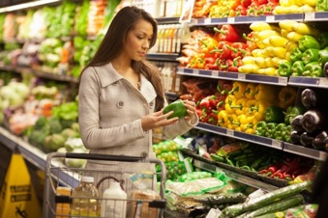
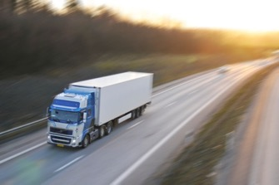

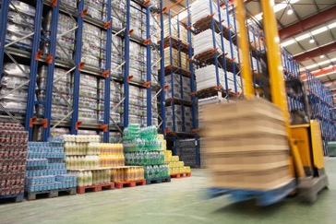
Traceability provides the starting point for other use cases
Freshness Management
Transportation
Optimization
Sustainability
Initiatives
Provenance
Inventory Optimization
Notes:
This is the “BEFORE” picture representing the “status quo” for business networks.
Each participant keeps their own ledger(s) which are updated to represent business transactions as they occur.
This is EXPENSIVE due to duplication of effort and intermediaries adding margin for services.
It is clearly INEFFICIENT, as the business conditions – the contract – is duplicated by every network participant
It is also VULNERABLE because if a central system (e.g. Bank) is compromised due to an incidents this affects the whole business network. Incidents can include fraud, cyber attack or a simple mistake.

Slide 12


Onboarding on to the Food Trust Network
Onboarding
IBM Onboarding Team Walkthrough
You select
initial product(s)
IBM
Food Trust
After the initial product(s) onboarding with IBM, you will be able to onboard more products,
data events, and ecosystem partners to the blockchain independently of the IBM Onboarding team.
Post-Onboarding
IBM Support Team
Support
You onboard
remaining products
IBM
Food Trust
Onboard Process Outcomes
Walk you through how to identify product(s) that can be traced on blockchain
Identify data events and elements that will be integrated into the blockchain
Push product(s) from client systems to the integration environment and perform combo testing with your testing partner
Work with technical staff in the integration of your system to Food Trust

Slide 13
Onboarding Outcomes
The onboarding process will enable you to continue using the solution after the onboarding is complete.
You will be enabled to
map business process events to
GS1 messages
extend data visibility to trading partners
onboard additional product(s)
gain access to IBM Food Trust support

Slide 14
Onboarding: Overall Process and Approach
IBM Onboarding Team
IBM Support Team
Discovery Workshop
GS1 Event
Mapping
Sample
Generation
Integration
Development
Data Linkage
Validation
UI
Testing
Promoted to Production
Hand-off to Support
Post-onboarding questions
Discovery
(Sprint 1)
Preparation
(Sprints 2-5)
Launch
(Sprint 6)
Post-Onboarding
Discovery Workshop: Readiness
Assessment
Identify client’s
onboarding
requirements
Ensure client
readiness
for onboarding
Start Production
Operations
Onboarding
Knowledge
Transfer
Client fully informed and prepared for onboarding
Assist client to develop integration requirements.
Start pushing
live data to blockchain
Seek client feedback and begin independent onboarding
Continuous training for the onboarding process
The IBM Onboarding Team will walk you through the onboarding process for your initial product. After the data for your first product has been pushed to the blockchain, the IBM Support Team will help support you as you onboard your remaining products.
The IBM Support Team is available to help after the initial onboarding process.

Slide 15
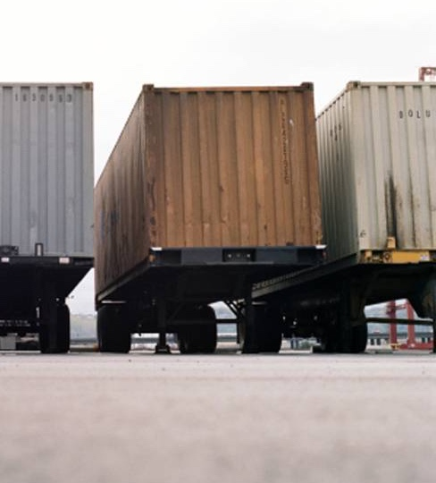
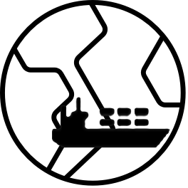
TradeLens
Notes:
Business never operates in isolation. They are participants in a business network.
Business Networks will connect customers, suppliers, banks and regulators and will cross geographical boundaries.
WEALTH is generated as goods and services move across this network; this flow is referred to as a MARKET.
Growth of wealth can be constrained if the network is heavily silo’d or inefficient.

Slide 16
IBM and Maersk have launched TradeLens
An open and neutral supply chain platform poised to transform the industry
TradeLens is built for the industry and offers benefits to trade participants from across the supply chain ecosystem
Responding to industry feedback, IBM and Maersk have revised the approach and are proceeding under a Collaboration Agreement, which offers greater flexibility and responsiveness to industry feedback
An Industry Advisory Board will help to shape the platform and drive standards
Maersk Line and Hamburg-Sud are participants under the same terms as other network members
Core platform components are available today under an Early Adopter program; full release remains on target for Q4 2018

Slide 17

The cost of global trade is estimated at $1.8 trillion annually¹ with potential savings from more efficient processes of ~10%
More than $16 trillion in goods are shipped across international borders each year | 80% of the goods consumers use daily are carried by the ocean shipping industry | By reducing barriers within the international supply chain, global trade could increase by nearly 15%, boosting economies and creating jobs² | In many cases the administrative cost of moving a container is higher than the cost of physically moving it
1) Maersk Strategy Group (May 19, 2016) based on World Bank data for World Trade Costs
2) The World Economic Forum: Enabling Trade Valuing Growth Opportunities 2013
17

Slide 18
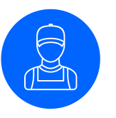
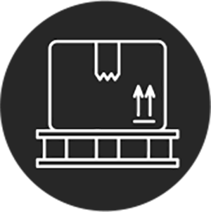

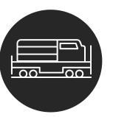
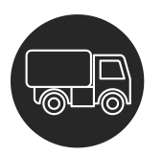


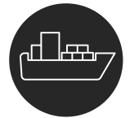
The case for a better way
TODAY
TOMORROW
Open global trade digitization platform
Authority
Consignee
Exporter
Authority
Authority
Forwarder
Exporter
Trucker
Rail
Forwarder
Consignee
Terminal
Authority
Authority
Carrier
Terminal
Authority
Authority
Carrier
Inconsistent information across organizational boundaries and “blind spots” throughout the supply chain hinder the efficient flow of goods
Complex, cumbersome, and costly peer-to-peer messaging
Manual, time-consuming, paper-based processes
Risk assessments often lack sufficient information; clearance processes subject to fraud
The administrative cost of handling a container shipment is comparable to the cost of the actual physical transport
Instant, secure access to end-to-end supply chain information; single source of the truth
Assurance of the authenticity and immutability of digital documents
Trusted cross-organizational workflows
Better risk assessments and fewer unnecessary interventions
Far lower administrative expenses and elimination of costs to move physical paper across international borders

Slide 19
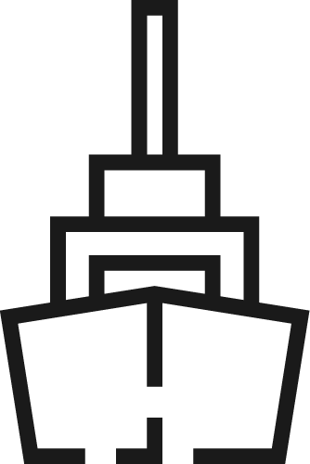

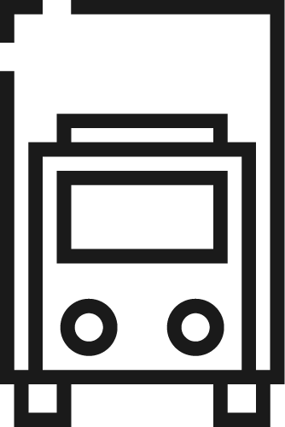
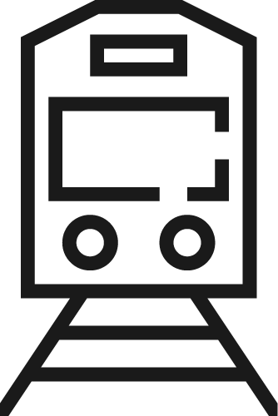
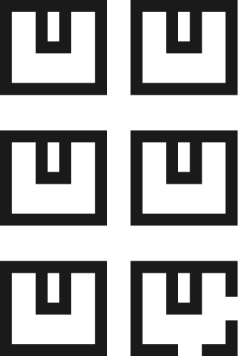
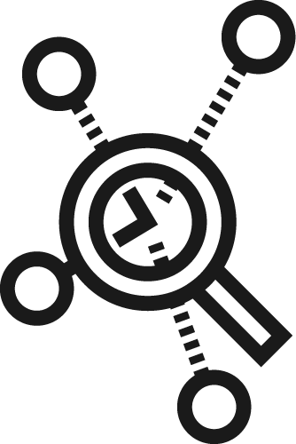
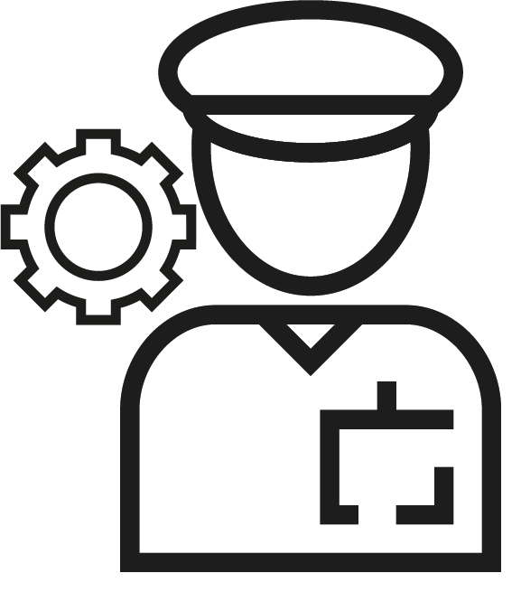
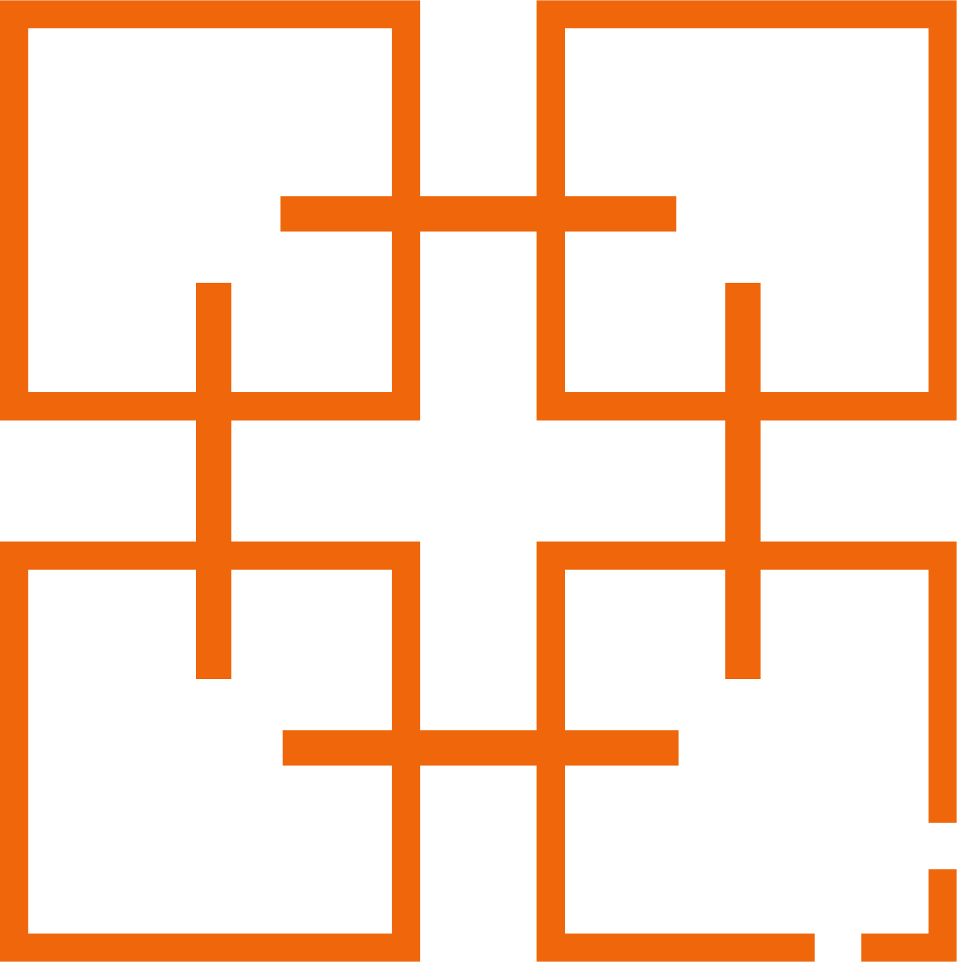
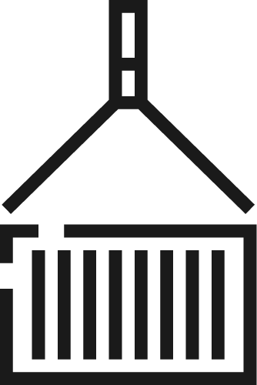
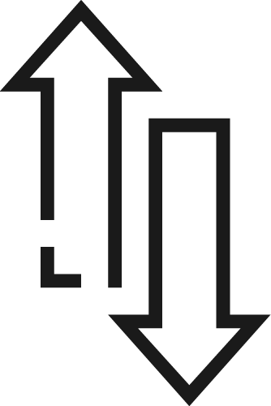
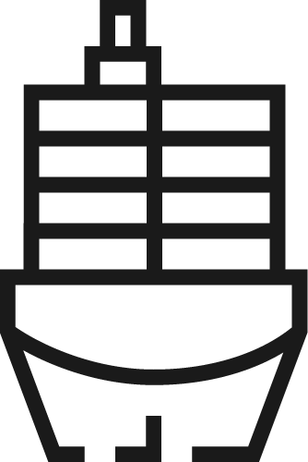
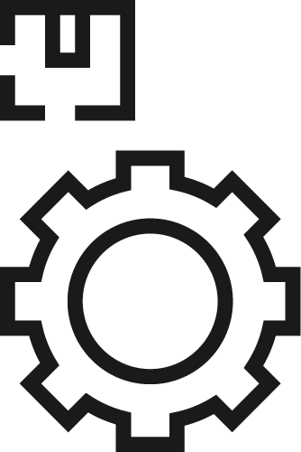
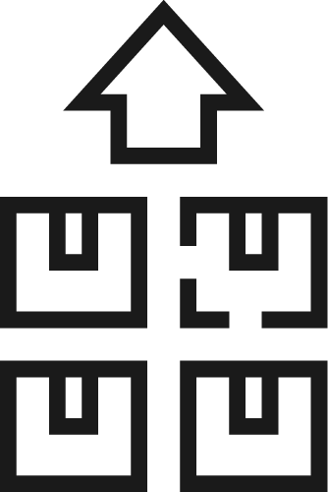
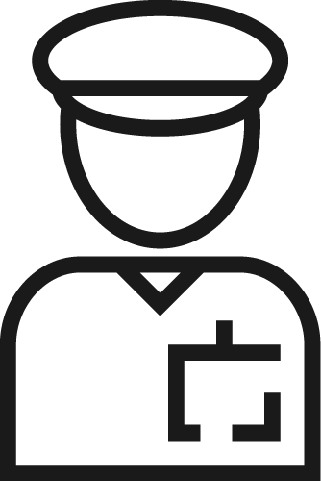
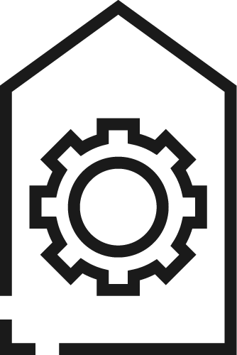
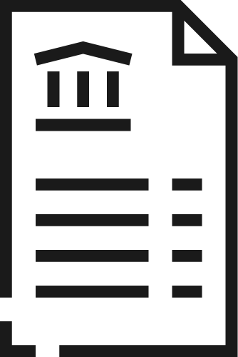

The TradeLens Platform
Digitizing the global supply chain
Inland Transportation
Connects the ecosystem Brings together all parties in the supply chain - including traders, freight forwarders, inland transportation, ports and terminals, ocean carriers, customs and other government authorities, and others - onto a Blockchain-based platform with a secure permission and identity framework Drives true information sharing Provides for the seamless, secure sharing of real-time, actionable supply chain information across all parties to a trade - encompassing shipping milestones, cargo details, trade documents, the structured data embedded in trade documents, customs filings, sensor readings, and more Fosters collaboration and trust Enables the digitization and automation of the cross-organization business processes integral to global trade, including import and export clearance, with Blockchain ensuring secure, auditable, and non-repudiable transactions Spurs innovation Lays the foundation for ongoing improvement and innovation through an open, non-proprietary API, the use of standards and promotion of interoperability, and the launch of an Applications Marketplace that parties can use to build and deploy TradeLens-powered applications for themselves, their partners, and their customers
Customs Brokers
Shippers / Beneficial Cargo Owner
Supply Chain Visibility Systems
Customs Systems
Ports and Terminals
THE PLATFORM IS BUILT ON AN OPEN TECHNOLOGY STACK AND IS UNDERPINNED BY BLOCKCHAIN TECHNOLOGY
Trade Associations
Supply Chain / Transportation Management Systems
Ocean Carriers
Freight Forwarders / 3PLs
Authorities
Port Community Systems; Terminal Operating Systems
Financial / Insurance Services

Slide 20


The TradeLens ecosystem
Provide and gain access to end-to-end supply chain information
Ocean carriers
Ports and terminals
Government authorities
Inland transportation
3rd party data providers
Primary consumers and beneficiaries of the platform
Shippers (BCOs, retailers, manufacturers, etc.)
Freight forwarders, customs brokers, 3PL
Network Members
Financial institutions
Network Members
Clients
TRADELENS PLATFORM
Offer value added services to the ecosystem through a platform marketplace
TradeLens offerings
Offerings from third party ISVs
Offerings from Network Members and Clients
Applications
Marketplace

Slide 21


World Wire

Slide 22

IBM Blockchain World Wire – the new global financial rail
IBM is transforming cross-border payments with IBM Blockchain World Wire, the integrated network for real-time clearing and settlement. This new global financial rail allows banks and financial institutions to send and settle payments around the globe with finality in a matter of seconds, eliminating enduring challenges that have long hampered the cross-border payments industry.
Today’s international payments systems are plagued by multiple intermediaries across multiple regions, each with their own rules, regulations, and practices. This makes cross-border payments and transactions costly, time-consuming, complicated and restrictive.

Slide 23

Current international payments

Slide 24

The IBM Blockchain World Wire difference
Sending money across borders today requires a series of intermediaries for both clearing and settlement, each adding time and cost to the process.
With IBM Blockchain World Wire, clearing and settlement with finality happens in near real-time. The solution uses digital assets to settle transactions, serving as an agreed-upon store of value exchanged between parties as well as integrating payment instruction messages.
It all means funds can now be transferred at a fraction of the cost and time of traditional correspondent banking.
Find out how to seamlessly integrate IBM Blockchain World Wire into your cross-border payment systems at https://ibm.com/blockchain/solutions/world-wire today.

Slide 25


Identity

Slide 26






The Different Dimensions of our identity
1. Me as an individual:
2. How I am represented:
3. How I interact:
Identity: Unique traits associated with an individual; the owner of personal identification information.
Identity Renderings: Digital or physical (paper/plastic) instrument as defined by providers.
Identity Interactions: Situational usage such as pay, identify, participate, enter.
Name
Age
Gender
Biometrics
Race
Family
Address
Birthplace
Nationality
Education
Profession
Workplace
Health
Reputation
Beliefs
Behavior
Habits
Sentiments
National ID
Work ID
Driving ID
Address History
Tax ID
Social Security ID
Social ID
Work History
Financial History
Medical History
Driving History
Social History
26

Slide 27



The Facts
Cyber attacks cost businesses as much as $400 billion a year.²
1339 breaches of data stores of individual names, Social Security, drivers license number, medical record, or financial records in 2017 in the US alone.¹
Banks spend $1 billion a year on identity management solutions²
175M records breached in 2017 that exposed millions of people’s identities¹
It could have been your identity.
[1] http://www.idtheftcenter.org/images/breach/2017Breaches/DataBreachReport_2017.pdf
[2] https://www.wired.com/beyond-the-beyond/2017/07/global-cybercrime-costs-trillion-dollars-maybe-3/
[3] https://www.accenture.com/_acnmedia/Accenture/Conversion-Assets/DotCom/Documents/Global/PDF/Dualpub_9/Accenture-Future-Identity-Banking.pdf
27
Notes:
http://www.idtheftcenter.org/images/breach/2017Breaches/DataBreachReport_2017.pdf [1]
https://www.wired.com/beyond-the-beyond/2017/07/global-cybercrime-costs-trillion-dollars-maybe-3/ [2]
https://www.accenture.com/_acnmedia/Accenture/Conversion-Assets/DotCom/Documents/Global/PDF/Dualpub_9/Accenture-Future-Identity-Banking.pdf [3]

Slide 28


The Problem
Online identity systems are broken…
Today, individuals and organizations are not in control over their identity. Personal information is often shared without our awareness and is honeypot of personal data for hackers to exploit.
Enterprises and traditional data aggregators realize the shift to decentralization
Costly
Liability
Difficult to establish trust
28

Slide 29

Decentralized Identity for trust & privacy at scale
Blockchain enables trust
Users can verify the identity of a person, organization or thing on the public ledger
Users create and manage cryptographic identities; no central certificate authority
Blockchain provides privacy
Zero knowledge proofs disclose only the information that needs to be shared
Blockchain provides scale
Removal of centralized issuers allows identity to scale at the edges
29

Slide 30




Sovrin is a self-sovereign identity network
Sovrin pushes identity to the edge of the network
A decentralized approach that establishes trust and puts the end user in control
Every person, organization, and thing has a digital wallet to control the flow of their identity
No PII is stored on the public ledger!
Cryptographic, point to point exchange of identity
Based on Hyperledger Indy technology
Decentralized Identifiers
Public Blockchain
30
Notes:
Identity is derived through distributed credentials, stored in an Owner’s wallet and issued by multiple parties in the forms of Decentralized Identifiers (DIDs). Verifications are issued independently only sharing the minimum needed information.

Slide 31



Sovrin Identity Concepts
Decentralized Identifier (DIDs)
User owned and governed
New type of identifier for verifiable, self sovereign identity
Fully under the control of person, institution, or thing
URL to relate an identity for a trusted interaction with a subject
Standardization for universal identifiers
Verifiable Credentials
Cryptographically backed statements of truth
Standard way of defining, exchanging, and verifying digital information
Ecosystem of issues, verifiers, and owners
Decentralized Key Management
User permissioning
Entities own their own keys and have a “public key” ring for those they interact with
“Public key” rings are used to resolve and verify interactions through DIDs
31

Slide 32
Decentralized Identity
Issuer
Issues
Issues
Credentials
Owner/Holder
Acquires, Stores, Presents
Presents
Credentials
Verifier
Requests, Verifies
Signs
Credentials
Countersigns
Credentials
Verifies
Signatures
Decentralized Identifiers (DIDs)
Public Permissioned Blockchain
Verifier
Requests, Verifies
Verifier
Requests, Verifies
Verifier
Requests, Verifiesv
Verifier
Requests, Verifiesv
All interactions between entities are point to point
The public ledger serves as the distributed root of trust instead of CAs
Credentials are accumulated over time through every peer to peer relationship
32

Slide 33






I’m a Doctor
Verifiable Credentials
University
Issues
Issues
Credentials
Doctor
Acquires, Stores, Presents
Presents
Credentials
Hospital
Requests, Verifies
Yes, you’re a Doctor
You’re now a Doctor
Signs
Credentials
Countersigns
Credentials
Verifies
Signatures
Decentralized Identifiers (DIDs)
Public Permissioned Blockchain
33

Slide 34
IBM Solutions
Food Trust
TradeLens
World Wire
Digital Identity
Your Solution
Notes:
This presentation is in three sections:
What is Blockchain: Covers the essentials of blockchain for business
Why is it relevant: Key use-cases
How can IBM help: IBM’s value proposition and the state of the technology

Slide 35

Good blockchain use-case or bad?
Food Provenance
Holiday Tracking Tool
Know Your Customer
Secure Document Store
Electronic Medical Records
Track Your Child
Notes:
Let’s start with discussing what makes a good use case with this slide build. Some of these are obvious good blockchain use cases, others are obvious bad ones! What’s really important is the discussion, which we will summarize on the following two slides.
There are two separable questions (1) is it a good blockchain use case? (2) is it a good first project opportunity (since blockchain technology is still emerging / changing quickly) and new to most customers.
Here are a few thoughts on each bubble:
SECURE DOCUMENT STORE: Blockchain is a store of proof, not a document store. It is not generally suitable for large files; typically hashes are stored on-chain rather than the data itself.
FOOD PROVENANCE : a public reference and a good blockchain use case BUT a challenging first project due to organisational complexity and cross industry network
HOLIDAY TRACKING TOOL : why would you need blockchain for this? Better done with more mature technology.
TRACK YOUR CHILD : again, not an obvious blockchain use case – perhaps more of an IoT project? Also, who would we trust to run the network? Different views on this one.
KNOW YOUR CUSTOMER : excellent blockchain use case – but HARD! For a first project, we would need to find a “corner” of the problem (e.g. elimination of multiple registration at different bank branches) to make it realisable.
ELECTRONIC MEDICAL RECORDS – again, a great blockchain use case – but due to the complexities and sensitivities involved – and in view of the complexities of the business network, not such a good place to start.

Slide 36
What makes a good blockchain use case?
Identifying a good blockchain use-case is not always easy!
However there should always be:
A business problem to be solved
That cannot be more efficiently solved with other technologies
An identifiable business network
With Participants, Assets and Transactions
A need for trust
Consensus, Immutability, Finality or Provenance
Notes:
These are three, pragmatic tests that we can apply to assess the use case suitability for blockchain. Let’s look at each in a little more detail.
Point 1 is in two parts. The first may sound obvious, but the only way to really get to grip with blockchain for business is to focus on what challenges your users currently. Our most successful projects are sponsored by the users in an organization who are unhappy with how things are working today. Another way to put this is to avoid “technology experiments” . . .
The second part of point 1 is important because blockchain is new, and not yet a stable, mature technology – so if the problem can be solved with (for example) a distributed database, let’s do that! Another way to put this is to avoid “blockchain religion” . . .
The second point in *direct* terms is no business network = not a blockchain use case! As we covered at the start of Blockchain Explained, the business network will generate wealth by transference of assets between participants in the form of transactions. Trust is engendered through consensus, immutability, finality & provenance. The more important TRUST is to the use case, the more VALUE blockchain will add.
The third point is important.

Slide 37
What makes a good first blockchain use case?
First use-cases are even more difficult to identify!
A limited scope, but still solves a real business problem
Minimum Viable Product in a few weeks of effort
A smaller business network
Usually without requiring regulators and consortia
Allows for scaling with more participants and scenarios
Consider shadow chains to mitigate risks
Start small, succeed and grow fast!
Notes:
OK – this is an important, separate point arising from the relative immaturity of blockchain technologies, and the customer’s need increase their levels of awareness before embarking on anything too ambitious.
We can talk for ever with a customer about (e.g.) smart contracts, but they will not really understand the true power they start to apply them to their business.
So the essence is BE AGILE – start small (with a clear business focus) – show success (by stakeholder demonstration) – grow fast (through focused, agile development).
This is easier if we limit the business network to a few participants initially, then grow it over time by demonstrating the MVP to the other participants.

Slide 38
Sample questions to ask for the selected use case:
What is the specific business problem / challenge that the first project will address?
What is the current way of solving this business problem?
Assuming the business problem is large, what specific aspects of this business problem will be addressed?
Who are the business network participants (organizations) involved and what are their roles?
Who are the specific people within the organization and what are their job roles?
What assets are involved and what is the key information associated with the assets?
What are the transactions involved, between whom, and what assets are associated with transactions?
What are the main steps in the current workflow and how are these executed by the business network participants?
What is the expected benefit of applying blockchain technology to the business problem for each of the network participants?
What legacy systems are involved? What degree of integration with the legacy systems is needed?

Slide 39
It is important to ideate potential use-cases
Notes:
It’s essential that the use case is clear and appropriate before kicking off the First Project. For this reason the first part of our Blockchain Design Thinking Workshop is focused on ideation > prioritization > fit test to ensure that we get this right.
More information is here (internal) : http://ibm.biz/BCFirstProject and here (external) : http://bit.ly/BlockUseCase

Slide 40
Assessing Business Value
It can be difficult to accurately quantify investment case for blockchain
Things to consider:
Existing Pain Points
Scope – participants, assets, transactions
Benefits: baseline, minimum viable ecosystem (MVE) & mature network
Blockchain Design Points
References
Blockchain Value Design (BVD) activity will help elaborate these items!
Notes:
A business value assessment for blockchain is difficult as with any nascent technology, because there are many unknowns - around maturity, adoption etc.
IBMers: Please contact Andrew Martin or Matthew Roberts for help with Business Value Assessments. For more information, see their blog post on the Blockchain Community here: https://w3-connections.ibm.com/blogs/a0bde329-ce7b-4b02-a134-88b7628a8e70/entry/Blockchain_A_value_based_engagement_model?lang=en_gb

Slide 41
Template – example only (Cross Border Supply Chain)
Problem
90% of goods in global trade are carried by the ocean shipping
industry each year. Costs associated with trade documentation
processing and administration are estimated to be up to 20%
the actual physical transportation costs.
Pain Points
Transport remains highly dependant on a flood of paper that is never digitised
Shipping information must pass through many hands, increasing potential for delays in transport.
One shipment can require sign-off from 30 unique organizations and up to 200 communications.
One lost form or late approval could leave the container stuck in port
The entire process can take more than one month..
Fraudulent changes may be made to the Bill of Lading
Solution
Manage and track the paper trail of tens of millions of shipping containers across the world by digitizing the supply chain process
Participants
Supplier, couriers (*2), customs (*2) , ports (*2), shipper and retailer ….
Asset & Trust
Need for trust around paperwork associated with a container
Transactions
Supplier prepares to ship, release container to courier, load to ship, clear customs, retailer receipt
Benefits benchmarks
- Value Tree
Baseline
Phase 1
Phase 2-3
F
M
M
M
Blockchain : Design Points
References
KPI’s (e.g.)
F
F
M
M
M
New
revenue
# new value propositions
-
-
1 to 3
Find new value propositions to exploit the network effect between members
Increase in customer satisfaction
-
5%
10%
Securely and transparently trace the container’s path through the supply chain on the blockchain
Add trust (Immutability and Provenance) around the Bill of Lading and other container paperwork
Automate the transit and shipping process with Smart Contracts reducing cycle times and delays
No reconciliation or matching of documentation with near instant updates - eliminates the need for audit and verification
Removes paper and intermediaries
Improve
client
experience
Increase in trade volumes
-
+5%
+15%
Cycle times (transit & shipping)
30 days
25 days
10 days
ANO -1
Reduce
transport
costs
Waste as % of total shipped
6%
5%
1%
ANO -2
Fraud and errors as % of total costs
5%
4%
0.5%
Documentation admin. as % of total costs
20%
15%
5%
Notes:
One example chart from a Business Value Assessment. Notice that the problem contains definitions of the participants, assets and transactions that are pertinent to the use-case.
Notice as well the benefits benchmarks. Baseline is the as-is scenario, Phase 1 is the minimum viable ecosystem and Phase 2 is the mature blockchain network.

